Slide 1
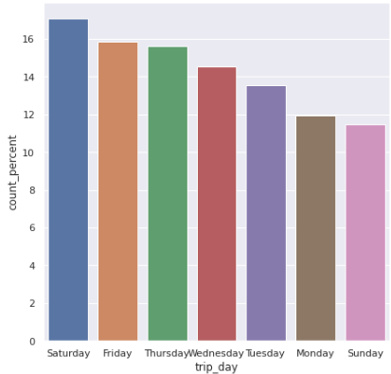
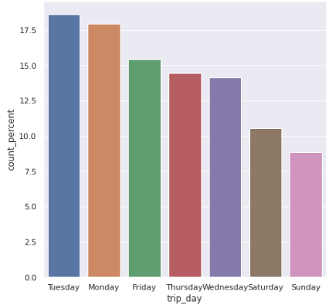
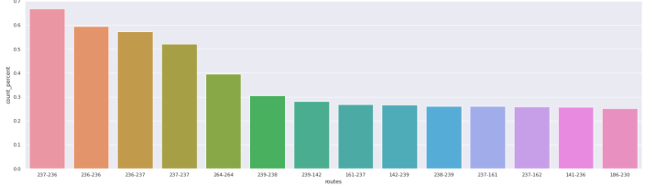
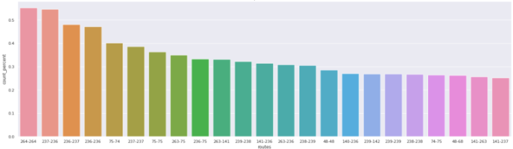
COVID Impact on Taxi uses in New York City
Overview
The project aims to analyze the impact of variables like fare amount, tip amount, total taxes duration, trip day, busiest location & routes on taxi uses and their correlation with each other for month Feb 2020 and June 20200
The Problem
COVID has impacted a lot of things, specially the travel agency, as no one was traveling when COVID hit the world. But some people were still travelling to reach to a safer place or meet their family loved ones.
What are the peak location, peak times and peak days with most travel
Does the fare amount and total amount shows any changes or it remain same
For passenger:
- It is better to travel on those days when least passengers are traveling
- It is better to avoid locations with highest traffic congestion
For travel agency:
- Implement more taxies on routes having highest demands
- Implement more taxis on Manhattan location
The Solution
Summary
Insights
- Only 8.7% of trips were conducted in June 2020 compared to Feb 2020
- All the busiest trip locations and trip routes are happening in Manhattan
- For longer trips, the fare amount charged is higher for June compared to Feb
- Top 4 busiest routes are the same for both months
- Tuesday had the highest taxi uses in June month while Saturday had the highest taxi uses for Feb
Reflections/
Next Steps
The project shows results that both sides travel agencies and passengers can take.
Passengers can plan their travel ahead of tiime to stay away from the congestion areas
Travel agencies can implement more taxis in higher demand areas.
The more in-depth analysis can be done like peak days and peak time of highest congestion in Manhattan
More advanced technique like statistics and ML can be applied to get better view of the results

